Slide 1



AIRPLANE CRASH
ANALYSIS
By Kanchan Prajapati

Slide 2
DATASET DESCRIPTION
Date
Time
Location
Operator
Flight #
Route
AC Type
Registration
cn/ln
Aboard
Aboard Passangers
Aboard Crew
Fatalities
Fatalities Passangers
Fatalities Crew
Ground

Slide 3


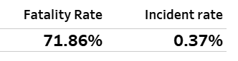
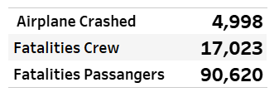
HIGHLIGHTS

Slide 4
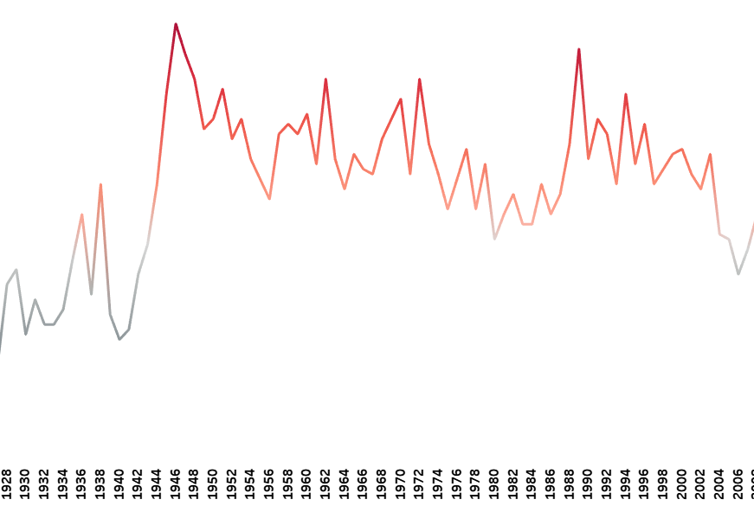
TEMPORAL ANALYSIS
This analysis focuses on the historical Evolution of plane crashes over the years.
The highest number of plane crashes occurred in 1946, totaling 88 incidents.
the second-highest number of plane crashes, observed in 1989 with 83 incidents.
Another notable year for plane crashes was 1947, which witnessed 82 incidents.

Slide 5
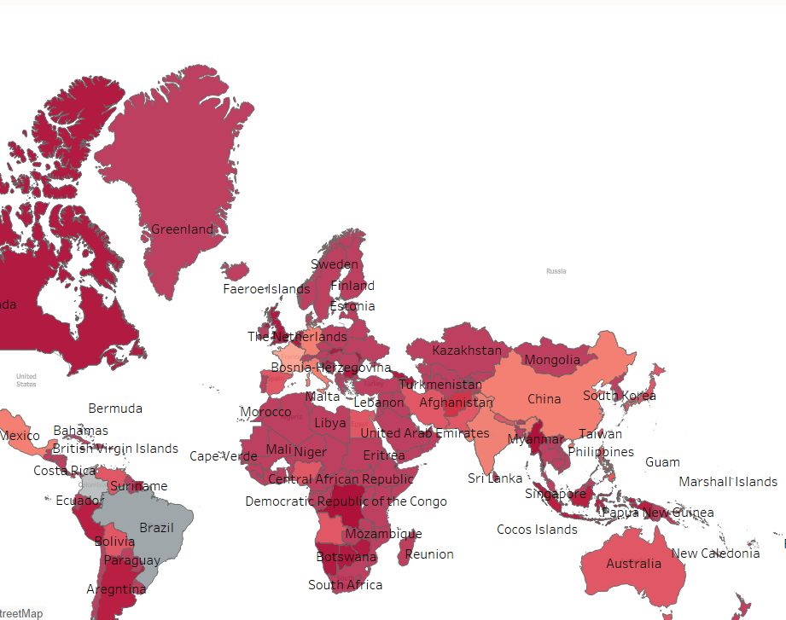
GEOSPATIAL ANALYSIS
This analysis focuses on examining country-wise plane crash data.
Brazil has the highest incidence of plane crashes, totaling 169 incidents.
Colombia closely follows with 148 incidents.
France ranks third with 114 incidents.

Slide 6
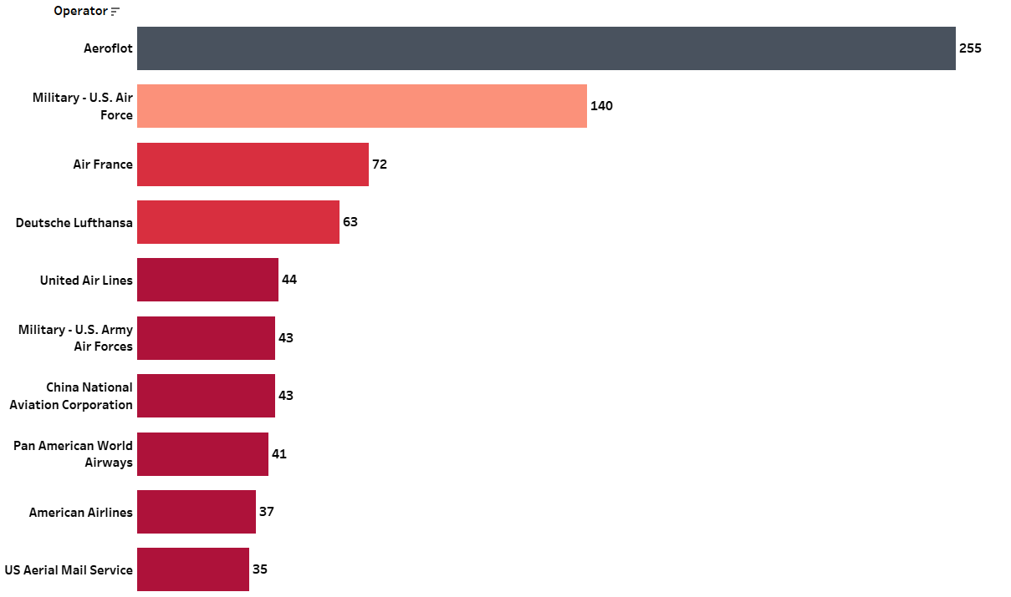
OPERATOR PERFORMANCE
This analysis showcases significant operators based on their participation in plane crashes.
Aeroflot ranks highest, involved in 225 plane crashes.
The US Military Air Force follows with 140 incidents.
Air France is third with 72 incidents.

Slide 7
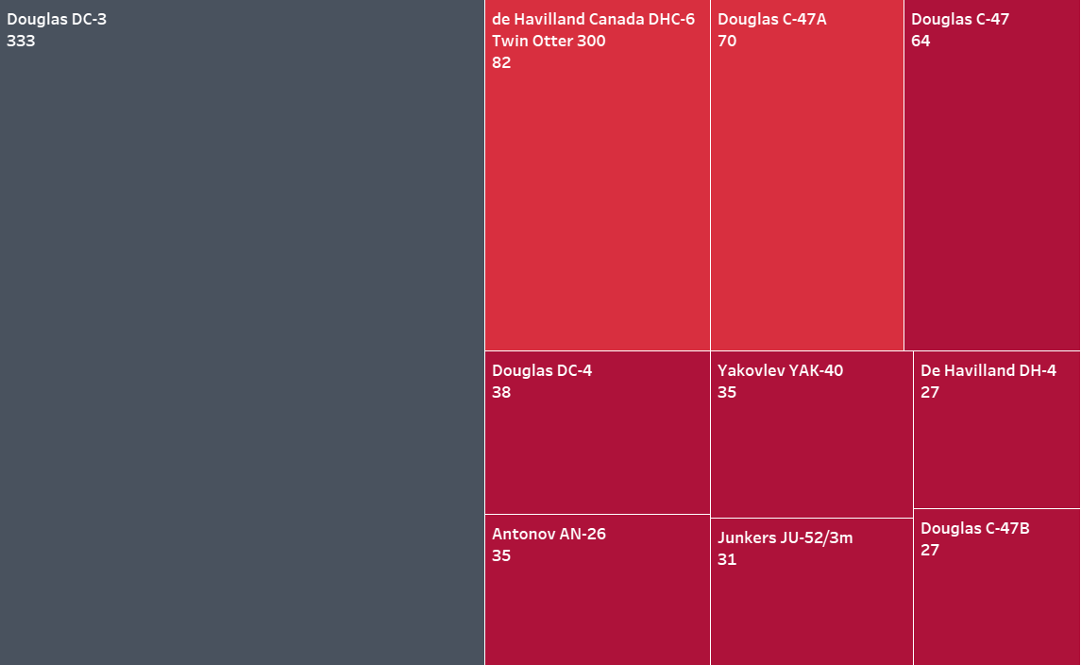
AIRCRAFT ANALYSIS
This analysis highlights the most frequently involved aircraft in plane crashes.
The Douglas DC-3 ranks first with 333 crashes.
The De Havilland DH-4 followed with 82 crashes.
The Douglas C47A-3 is third with 70 crashes.

Slide 8
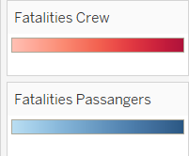
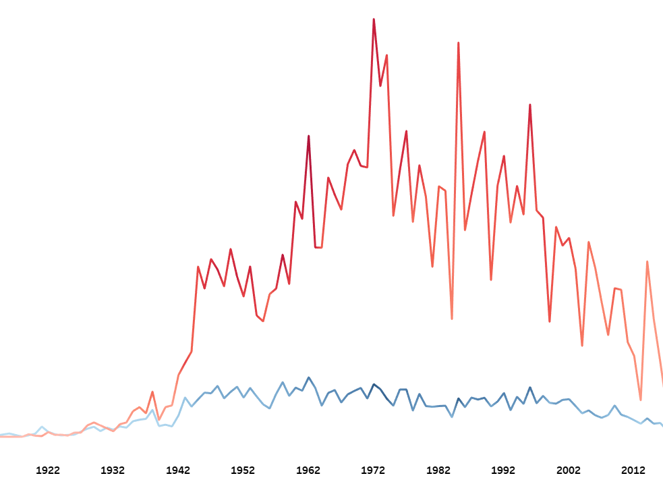
FATALITY TRENDS
The analysis examines trends and patterns in passenger and crew fatalities over time.
In 1996, there were 850 passenger fatalities.
1972 witnessed 875 fatalities, followed by 1,082 fatalities in 1985.
Crew fatalities peaked at 114 in 1958, followed by 135 in 1966, and 126 in 1996.

Slide 9
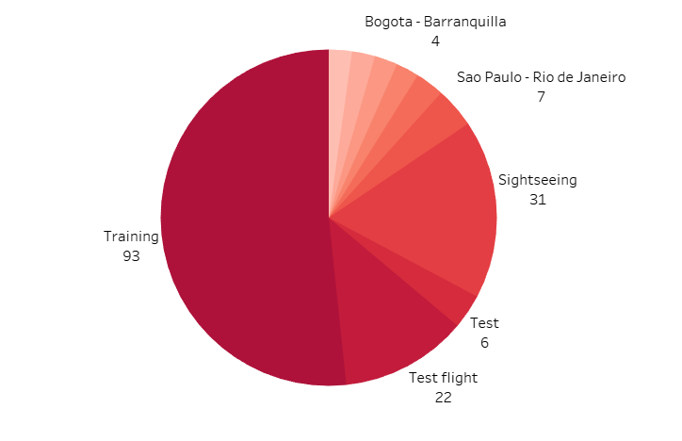
ROUTE ANALYSIS
This analysis focuses on identifying the top 10 routes associated with plane crashes.

Slide 10
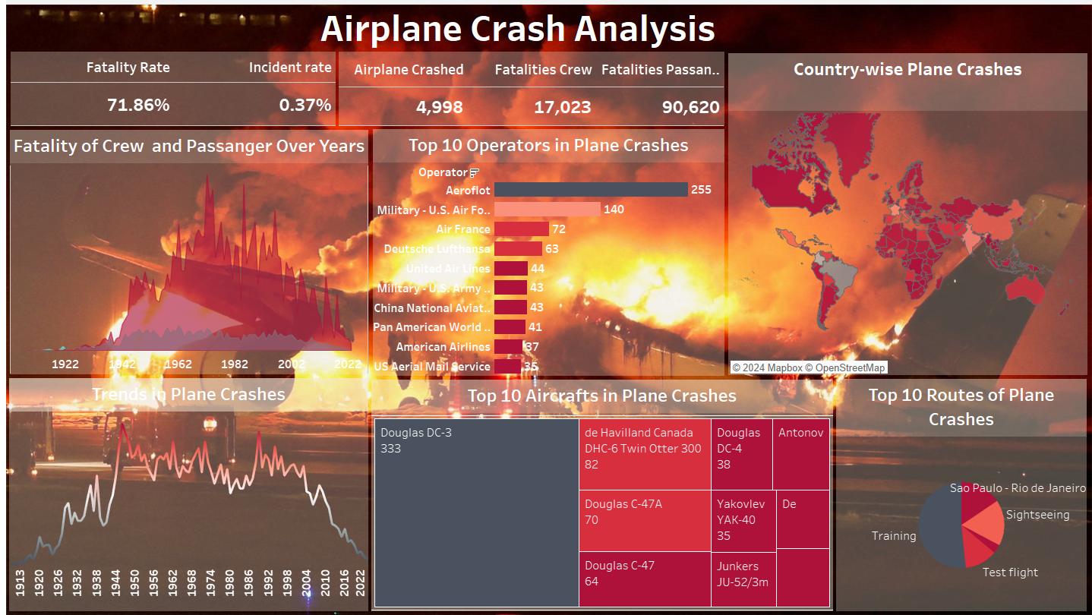
DASHBOARD

Slide 11

CONCLUSION
The analysis highlights the complex dynamics of airplane crashes, shaped by various factors such as historical trends, operator performance, aircraft characteristics, and route-specific considerations. By utilizing these insights, stakeholders can prioritize strategic interventions and initiatives to improve aviation safety and minimize the likelihood of future incidents. This comprehensive approach is essential for fostering a safer and more secure aviation environment for all.

